Slide 1

AI and the Environment 2:
Linear Regression

Slide 2
Linear Regression
Well here we go getting a little bit more technical thankfully we a linear regression is the easiest form of ML and is a nice simple go to for ML.
If you understand linear regression in statistics it is almost the exact same thing.
Realistically we just use different terminology.

Slide 3
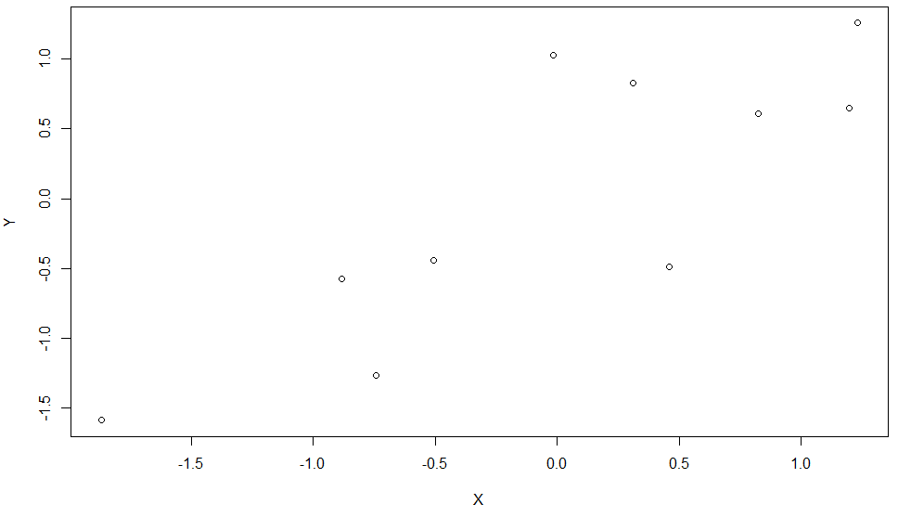
Linear Regression
Lets go over some of the principals of linear regression just in a general statistical point of view.
Lets take a look at a random bunch of data:

Slide 4
Linear Regression
So here we have 10 data point, which isn’t very much but the point of a linear regression is to find the pattern from this data.
The point of finding this pattern is to make predictions about the relationship between X and Y.

Slide 5
Linear Regression
The point of finding this pattern is to make predictions about the relationship between X and Y.
Making a prediction about something is exactly what ML is meant to do so linear Regression is a nice simple way to do it.

Slide 6
Linear Regression
So when we are looking at an explanatory variable and a predictor variable what do we do to try and get a prediction based on any explanatory input?
Well it’s in the name… Draw a line.

Slide 7
Linear Regression
So when we are looking at an explanatory variable and a predictor variable what do we do to try and get a prediction based on any explanatory input?
Well it’s in the name… Draw a line.

Slide 8
Linear Regression
How do we describe a line with Maths?

Slide 9
Linear Regression
How do we describe a line with Maths?
A line is a vector – It describes the movement between two locations in “space”

Slide 10
Linear Regression
How do we describe a line with Maths?
A line is a vector – It describes the movement between two locations in “space”

Slide 11
Linear Regression
A line is a vector – It describes the movement between two locations in “space”
What movement does this vector describe?

Slide 12
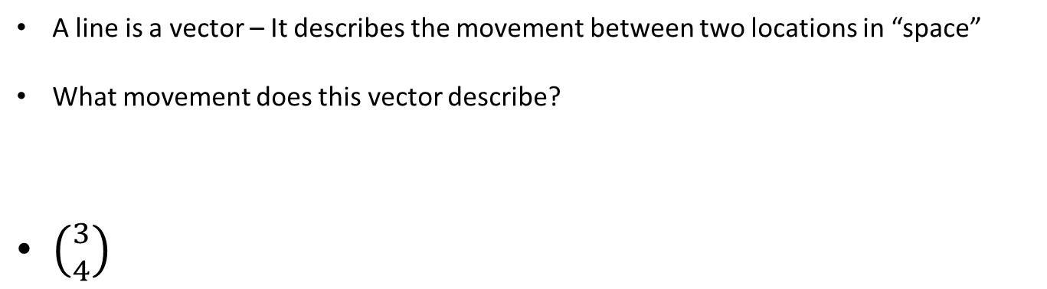
Linear Regression
A line is a vector – It describes the movement between two locations in “space”
What movement does this vector describe?
$\left({3 \atop 4}\right)$

Slide 13
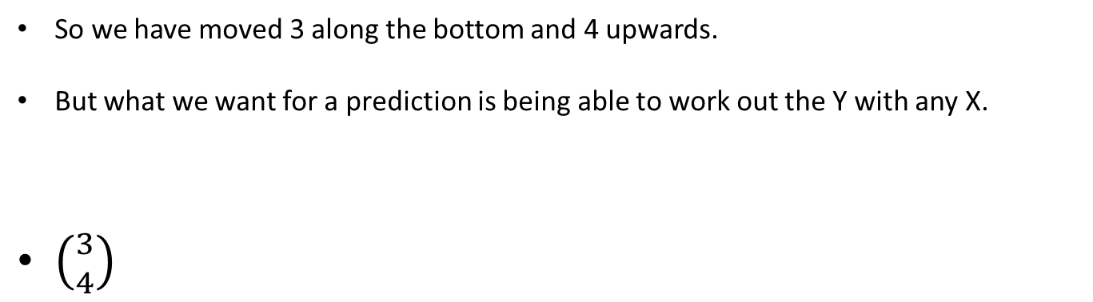
Linear Regression
So we have moved 3 along the bottom and 4 upwards.
But what we want for a prediction is being able to work out the Y with any X.
$\left({3 \atop 4}\right)$

Slide 14
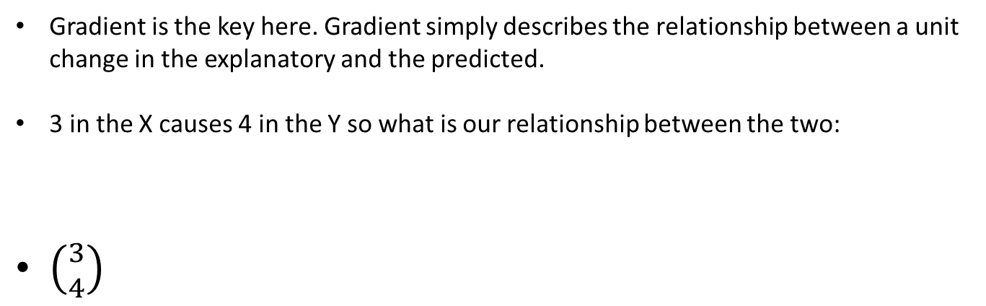
Linear Regression
Gradient is the key here. Gradient simply describes the relationship between a unit change in the explanatory and the predicted.
3 in the X causes 4 in the Y so what is our relationship between the two:
$\left({3 \atop 4}\right)$

Slide 15
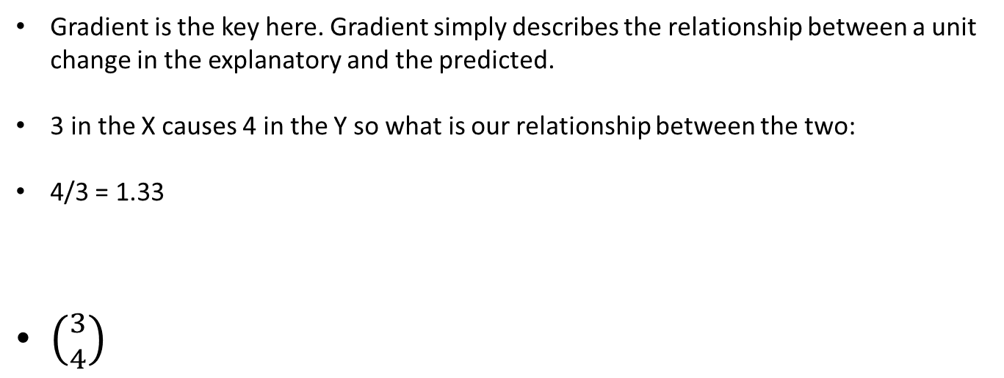
Linear Regression
Gradient is the key here. Gradient simply describes the relationship between a unit change in the explanatory and the predicted.
3 in the X causes 4 in the Y so what is our relationship between the two:
4/3 = 1.33
$\left({3 \atop 4}\right)$

Slide 16
Linear Regression
So we can use a line to make a prediction based on a given input by calculating the gradient of a line.
This gradient is calculated as the ratio between the change in Y/X so if we call this gradient m
m = ΔY/X

Slide 17
Linear Regression
m = Δ Y/X
We have an equation that tells us how to work out the gradient but this isn’t everything for a line.

Slide 18
Linear Regression
m = Δ Y/X
We have an equation that tells us how to work out the gradient but this isn’t everything for a line.

Slide 19
Linear Regression
m = Δ Y/X
We have an equation that tells us how to work out the gradient but this isn’t everything for a line.
These lines all have the same gradient yet sit at different points on the graph.

Slide 20
Linear Regression
m = Δ Y/X
These lines all have the same gradient yet sit at different points on the graph.
We need to think about the relative starting point of the line or the intercept.

Slide 21
Linear Regression
m = Δ Y/X
These lines all have the same gradient yet sit at different points on the graph.
We need to think about the relative starting point of the line or the intercept.

Slide 22
Linear Regression
m = Δ Y/X
The only difference between these lines is their relative location of crossing the y access or the y intercept.
This is a constant that is regardless of the current location on the x axis.

Slide 23
Linear Regression
m = Δ Y/X
This is a constant that is regardless of the current location on the x axis.
Y intercept constant = c

Slide 24
Linear Regression
So to predict a point on the Y axis we need to know the gradient of the line m (based on the change in y over the change in x) and the intercept of the line c (constant).

Slide 25
Linear Regression
So to predict a point on the Y axis we need to know the gradient of the line m (based on the change in y over the change in x) and the intercept of the line c (constant).
y = mx + c

Slide 26
Linear Regression
So to predict a point on the Y axis we need to know the gradient of the line m (based on the change in y over the change in x) and the intercept of the line c (constant).
y = mx + c
This is the origin of the
linear equation.

Slide 27
Linear Regression
In machine learning we use the linear equation but we talk about it in weights and biases terms.
y = wx + b
Weights is gradient
Bias is the constant y
intercept.

Slide 28
Linear Regression
y = wx + b
But a line connects two points, which two points should we choose?

Slide 29
Linear Regression
y = wx + b
But a line connects two points, which two points should we choose?

Slide 30
Linear Regression
y = wx + b
But a line connects two points, which two points should we choose?

Slide 31
Linear Regression
y = wx + b
But a line connects two points, which two points should we choose?

Slide 32
Linear Regression
y = wx + b
None of the above?
This is where our learning
comes in.

Slide 33
Linear Regression - Error
Along with weights and biases we have to use our concept of error to find the ideal weight and bias (gradient and intercept).

Slide 34
Linear Regression - Error
How do we calculate error in a linear regulation?
There are two major ways to do it:
Ordinary least square
Gradient descent

Slide 35
Linear Regression – Ordinary Least Square
Least square regression comes from minimising the error between each point and the line.

Slide 36
Linear Regression – Ordinary Least Square
Least square regression comes from minimising the error between each point and the line.

Slide 37
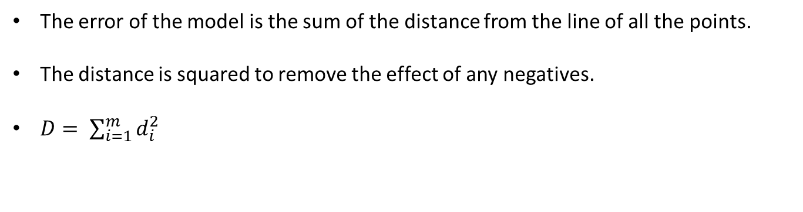
Linear Regression – Ordinary Least Square
The error of the model is the sum of the distance from the line of all the points.
The distance is squared to remove the effect of any negatives.
$D= \sum_{i=1}^{m}{d_{i}^{2}}$

Slide 38
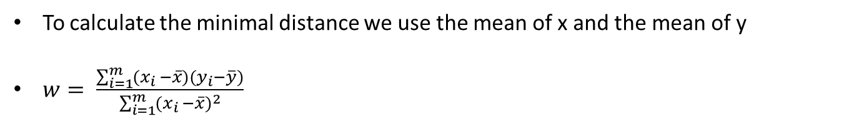
Linear Regression – Ordinary Least Square
To calculate the minimal distance we use the mean of x and the mean of y
$w= \frac{\sum_{i=1}^{m}{(x_{i }−\overline{x})(y_{i}−\overline{y})}}{\sum_{i=1}^{m}{{(x_{i }−\overline{x})}^{2}}}$

Slide 39
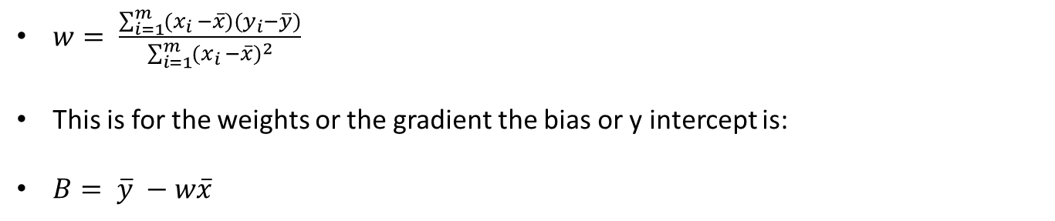
Linear Regression – Ordinary Least Square
$w= \frac{\sum_{i=1}^{m}{(x_{i }−\overline{x})(y_{i}−\overline{y})}}{\sum_{i=1}^{m}{{(x_{i }−\overline{x})}^{2}}}$
This is for the weights or the gradient the bias or y intercept is:
$B= \overline{y} −w\overline{x}$

Slide 40

Linear Regression – Ordinary Least Square
We have measured the distance from the mean to get the gradient of a line but we still need to measure the error.
We can use a standard error measure like root mean square error to calculate this.
$w= \frac{\sum_{i=1}^{m}{(x_{i }−\overline{x})(y_{i}−\overline{y})}}{\sum_{i=1}^{m}{{(x_{i }−\overline{x})}^{2}}}$
$B= \overline{y} −w\overline{x}$

Slide 41

Linear Regression – Ordinary Least Square
We can use a standard error measure like root mean square error to calculate this.
$RMSE= \sqrt{\sum_{i=1}^{m}{\frac{{\left(\hat{y}−y_{i}\right)}^{2}}{m}}}$
$w= \frac{\sum_{i=1}^{m}{(x_{i }−\overline{x})(y_{i}−\overline{y})}}{\sum_{i=1}^{m}{{(x_{i }−\overline{x})}^{2}}}$
$B= \overline{y} −w\overline{x}$

Slide 42

Linear Regression – Ordinary Least Square
$RMSE= \sqrt{\sum_{i=1}^{m}{\frac{{\left(\hat{y}−y_{i}\right)}^{2}}{m}}}$
In this case it is the predicted value is taken straight from the line at the same x as the y value.
$w= \frac{\sum_{i=1}^{m}{(x_{i }−\overline{x})(y_{i}−\overline{y})}}{\sum_{i=1}^{m}{{(x_{i }−\overline{x})}^{2}}}$
$B= \overline{y} −w\overline{x}$

Slide 43
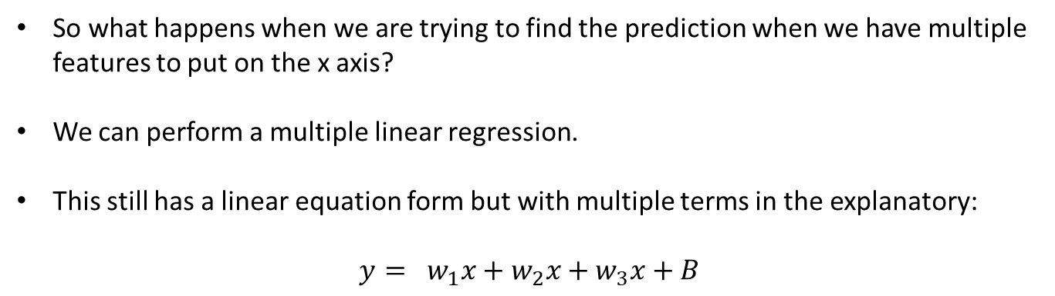
Linear Regression – Gradient Descent
So what happens when we are trying to find the prediction when we have multiple features to put on the x axis?
We can perform a multiple linear regression.
This still has a linear equation form but with multiple terms in the explanatory:
$$y= w_{1}x+w_{2}x+w_{3}x+B$$

Slide 44
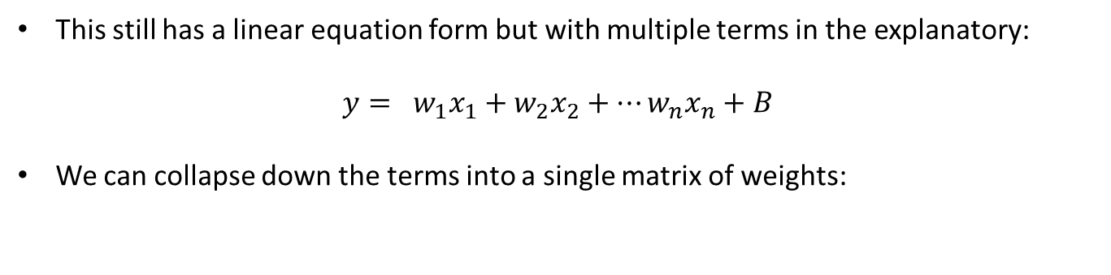
Linear Regression – Gradient Descent
This still has a linear equation form but with multiple terms in the explanatory:
$$y= w_{1}x_{1}+w_{2}x_{2}+…w_{n}x_{n}+B$$
We can collapse down the terms into a single matrix of weights:

Slide 45
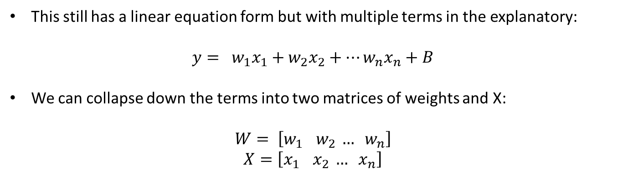
Linear Regression – Gradient Descent
This still has a linear equation form but with multiple terms in the explanatory:
$$y= w_{1}x_{1}+w_{2}x_{2}+…w_{n}x_{n}+B$$
We can collapse down the terms into two matrices of weights and X:
$$W= \left[w_{1}{ w}_{2} … w_{n}\right]$$
$$X=\left[x_{1}{ x}_{2} … x_{n}\right]$$

Slide 46
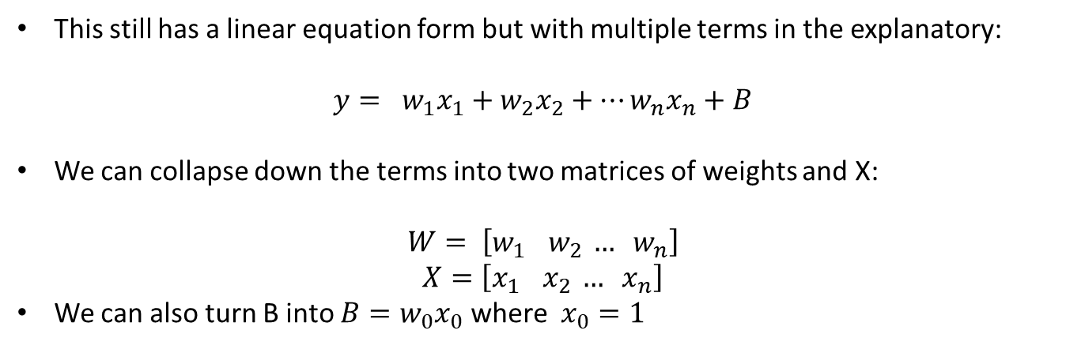
Linear Regression – Gradient Descent
This still has a linear equation form but with multiple terms in the explanatory:
$$y= w_{1}x_{1}+w_{2}x_{2}+…w_{n}x_{n}+B$$
We can collapse down the terms into two matrices of weights and X:
$$W= \left[w_{1}{ w}_{2} … w_{n}\right]$$
$$X=\left[x_{1}{ x}_{2} … x_{n}\right]$$
We can also turn B into $B=w_{0}x_{0}$ where $x_{0}=1$

Slide 47
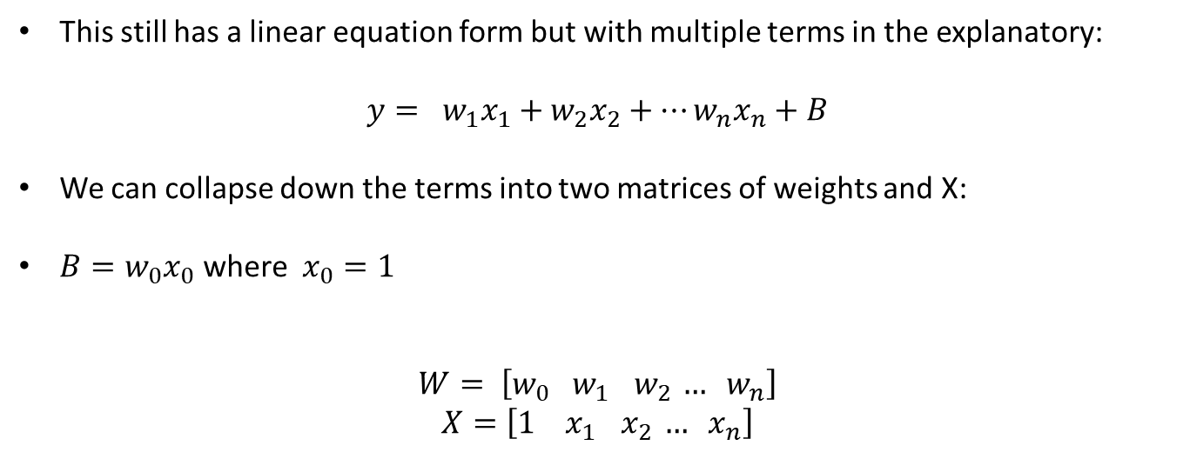
Linear Regression – Gradient Descent
This still has a linear equation form but with multiple terms in the explanatory:
$$y= w_{1}x_{1}+w_{2}x_{2}+…w_{n}x_{n}+B$$
We can collapse down the terms into two matrices of weights and X:
$B=w_{0}x_{0}$ where $x_{0}=1$
$$W= \left[w_{0} w_{1}{ w}_{2} … w_{n}\right]$$
$$X=\left[{1 x}_{1}{ x}_{2} … x_{n}\right]$$

Slide 48
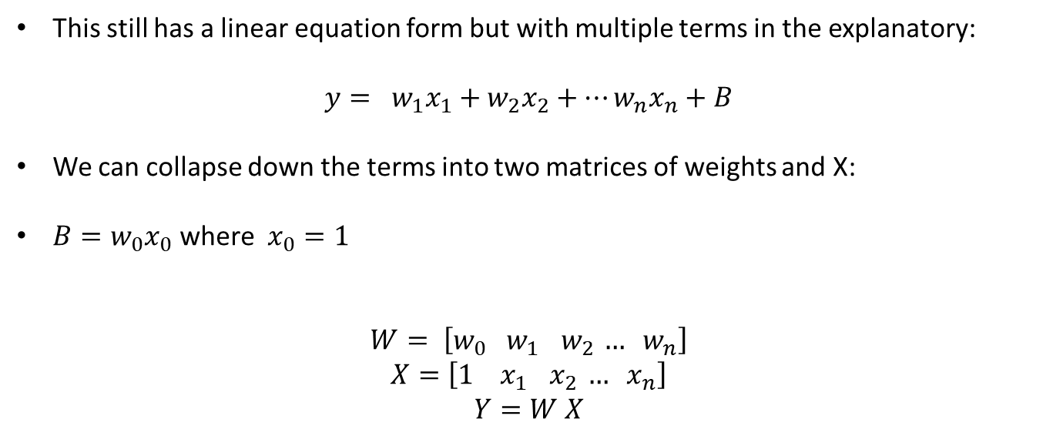
Linear Regression – Gradient Descent
This still has a linear equation form but with multiple terms in the explanatory:
$$y= w_{1}x_{1}+w_{2}x_{2}+…w_{n}x_{n}+B$$
We can collapse down the terms into two matrices of weights and X:
$B=w_{0}x_{0}$ where $x_{0}=1$
$$W= \left[w_{0} w_{1}{ w}_{2} … w_{n}\right]$$
$$X=\left[{1 x}_{1}{ x}_{2} … x_{n}\right]$$
$$Y=W X$$

Slide 49
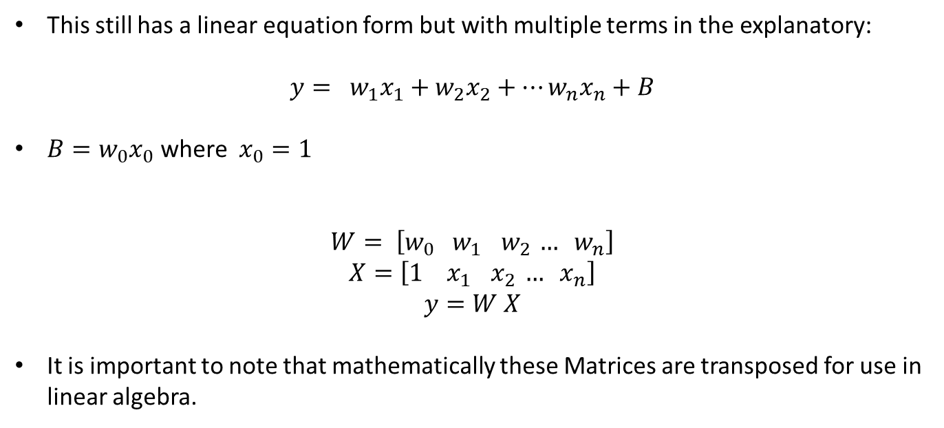
Linear Regression – Gradient Descent
This still has a linear equation form but with multiple terms in the explanatory:
$$y= w_{1}x_{1}+w_{2}x_{2}+…w_{n}x_{n}+B$$
$B=w_{0}x_{0}$ where $x_{0}=1$
$$W= \left[w_{0} w_{1}{ w}_{2} … w_{n}\right]$$
$$X=\left[{1 x}_{1}{ x}_{2} … x_{n}\right]$$
$$y=W X$$
It is important to note that mathematically these Matrices are transposed for use in linear algebra.

Slide 50
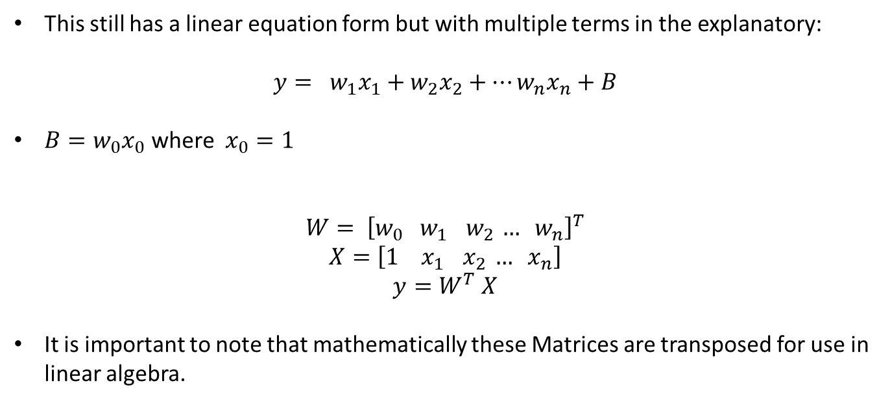
Linear Regression – Gradient Descent
This still has a linear equation form but with multiple terms in the explanatory:
$$y= w_{1}x_{1}+w_{2}x_{2}+…w_{n}x_{n}+B$$
$B=w_{0}x_{0}$ where $x_{0}=1$
$$W= {\left[w_{0} w_{1}{ w}_{2} … w_{n}\right]}^{T}$$
$$X=\left[{1 x}_{1}{ x}_{2} … x_{n}\right]$$
$$y=W^{T} X$$
It is important to note that mathematically these Matrices are transposed for use in linear algebra.

Slide 51

Linear Regression – Gradient Descent
$$y=W^{T} X$$
We want to turn this into a function for use in further equations:
$$y_{W}\left(x\right)= W^{T} x$$

Slide 52
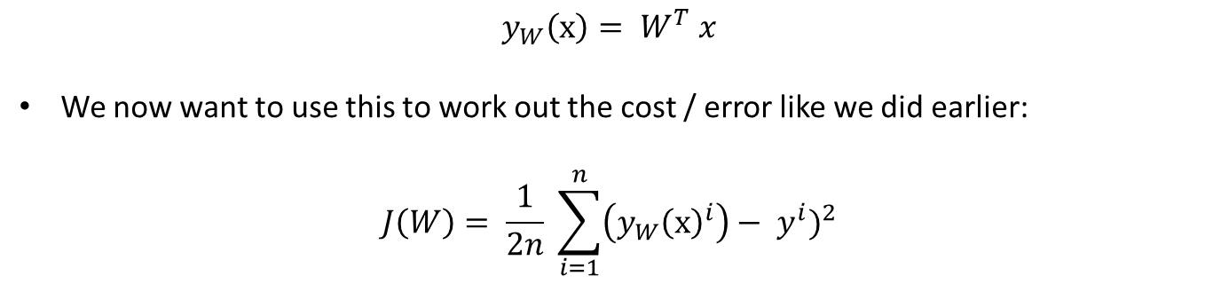
Linear Regression – Gradient Descent
$$y_{W}\left(x\right)= W^{T} x$$
We now want to use this to work out the cost / error like we did earlier:
$$J\left(W\right)= \frac{1}{2n} \sum_{i=1}^{n}{{\left({y_{W}\left(x\right)}^{i}\right)− y^{i})}^{2}}$$

Slide 53
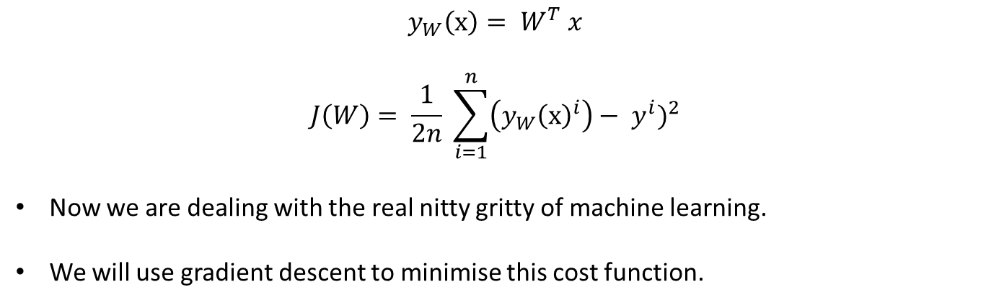
Linear Regression – Gradient Descent
$$y_{W}\left(x\right)= W^{T} x$$
$$J\left(W\right)= \frac{1}{2n} \sum_{i=1}^{n}{{\left({y_{W}\left(x\right)}^{i}\right)− y^{i})}^{2}}$$
Now we are dealing with the real nitty gritty of machine learning.
We will use gradient descent to minimise this cost function.

Slide 54
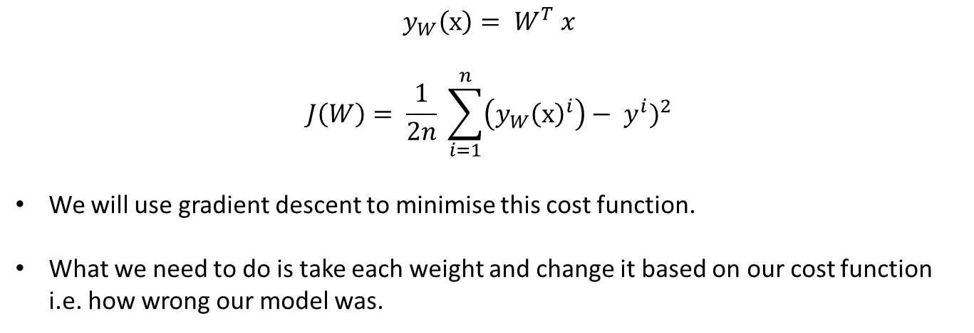
Linear Regression – Gradient Descent
$$y_{W}\left(x\right)= W^{T} x$$
$$J\left(W\right)= \frac{1}{2n} \sum_{i=1}^{n}{{\left({y_{W}\left(x\right)}^{i}\right)− y^{i})}^{2}}$$
We will use gradient descent to minimise this cost function.
What we need to do is take each weight and change it based on our cost function i.e. how wrong our model was.

Slide 55
Linear Regression – Gradient Descent
$$y_{W}\left(x\right)= W^{T} x$$
$$J\left(W\right)= \frac{1}{2n} \sum_{i=1}^{n}{{\left({y_{W}\left(x\right)}^{i}\right)− y^{i})}^{2}}$$
We will use gradient descent to minimise this cost function.
What we need to do is take each weight and change it based on our cost function i.e. how wrong our model was.

Slide 56
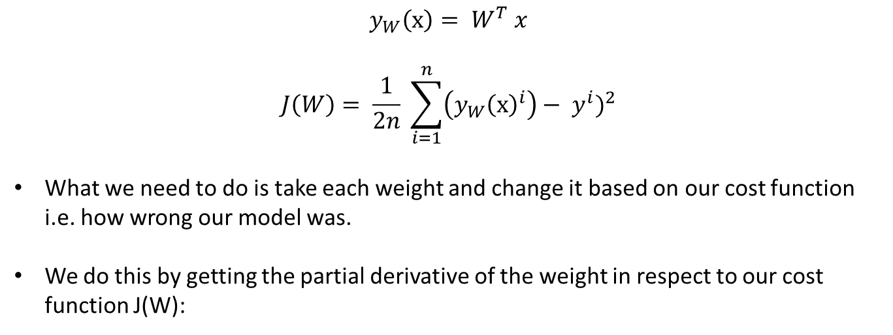
Linear Regression – Gradient Descent
$$y_{W}\left(x\right)= W^{T} x$$
$$J\left(W\right)= \frac{1}{2n} \sum_{i=1}^{n}{{\left({y_{W}\left(x\right)}^{i}\right)− y^{i})}^{2}}$$
What we need to do is take each weight and change it based on our cost function i.e. how wrong our model was.
We do this by getting the partial derivative of the weight in respect to our cost function J(W):

Slide 57
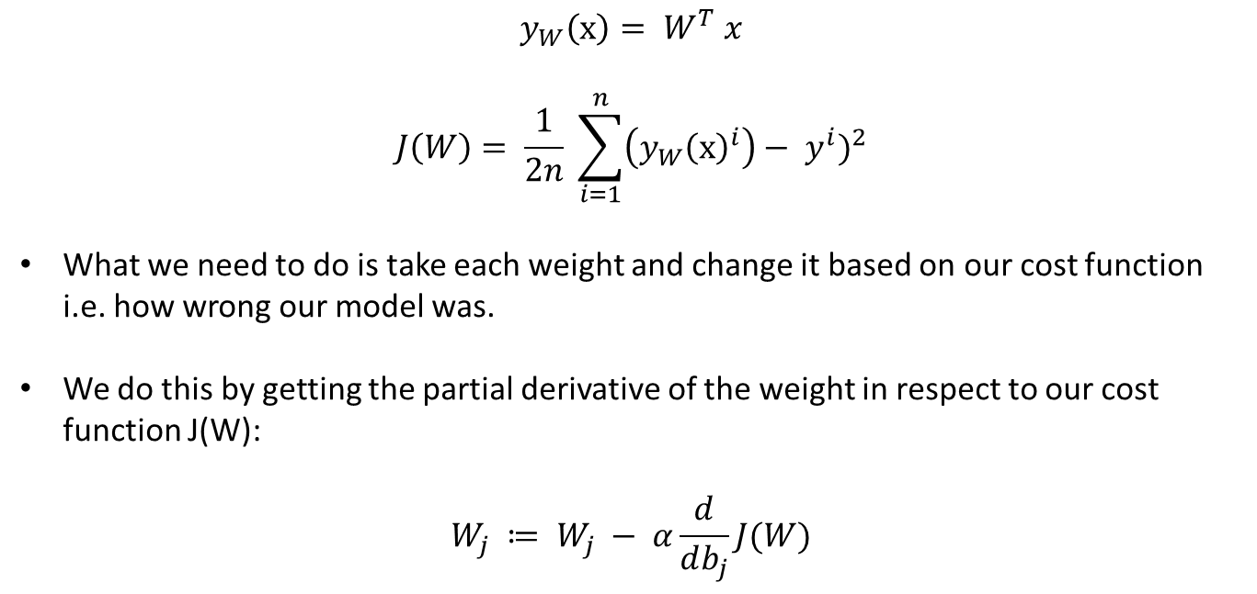
Linear Regression – Gradient Descent
$$y_{W}\left(x\right)= W^{T} x$$
$$J\left(W\right)= \frac{1}{2n} \sum_{i=1}^{n}{{\left({y_{W}\left(x\right)}^{i}\right)− y^{i})}^{2}}$$
What we need to do is take each weight and change it based on our cost function i.e. how wrong our model was.
We do this by getting the partial derivative of the weight in respect to our cost function J(W):
$$W_{j} ≔ W_{j} − α\frac{d}{db_{j}}J(W)$$

Slide 58
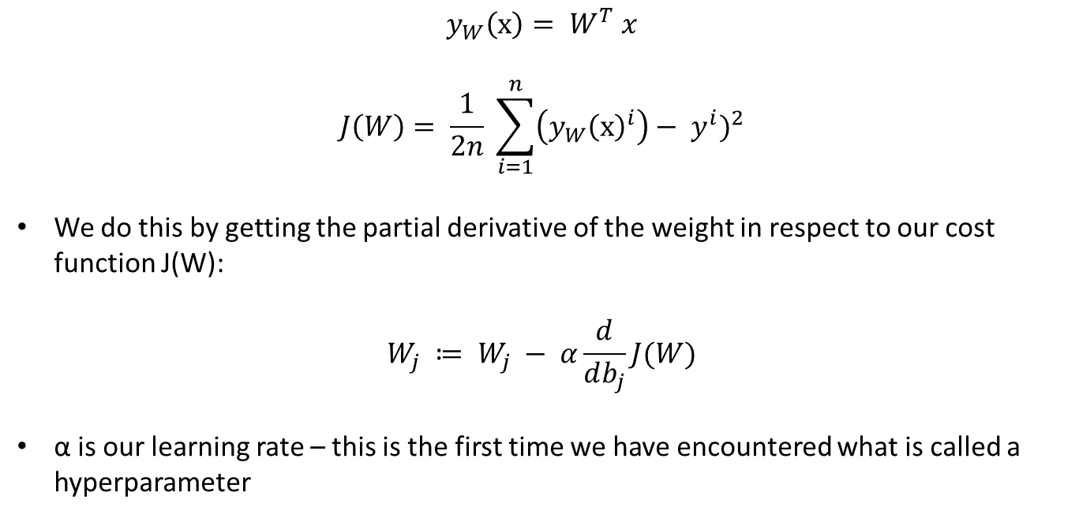
Linear Regression – Gradient Descent
$$y_{W}\left(x\right)= W^{T} x$$
$$J\left(W\right)= \frac{1}{2n} \sum_{i=1}^{n}{{\left({y_{W}\left(x\right)}^{i}\right)− y^{i})}^{2}}$$
We do this by getting the partial derivative of the weight in respect to our cost function J(W):
$$W_{j} ≔ W_{j} − α\frac{d}{db_{j}}J(W)$$
α is our learning rate – this is the first time we have encountered what is called a hyperparameter

Slide 59
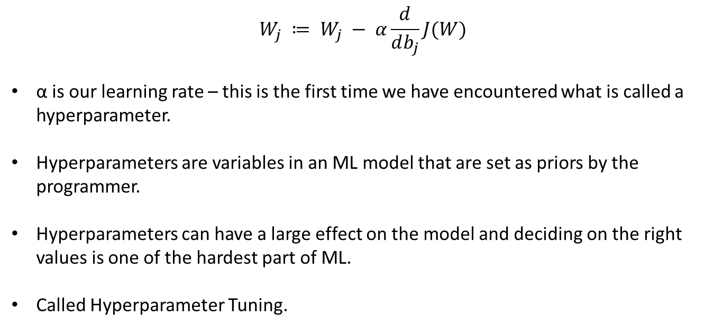
Hyperparameters
$$W_{j} ≔ W_{j} − α\frac{d}{db_{j}}J(W)$$
α is our learning rate – this is the first time we have encountered what is called a hyperparameter.
Hyperparameters are variables in an ML model that are set as priors by the programmer.
Hyperparameters can have a large effect on the model and deciding on the right values is one of the hardest part of ML.
Called Hyperparameter Tuning.

Slide 60
Hyperparameter tuning
Called Hyperparameter Tuning.
Generally speaking you will know what would be a reasonable starting value for a hyperparameter.
From there finding the best one is a bit of trial and error, generally you will try multiple values to maximise the accuracy of your model.

Slide 61
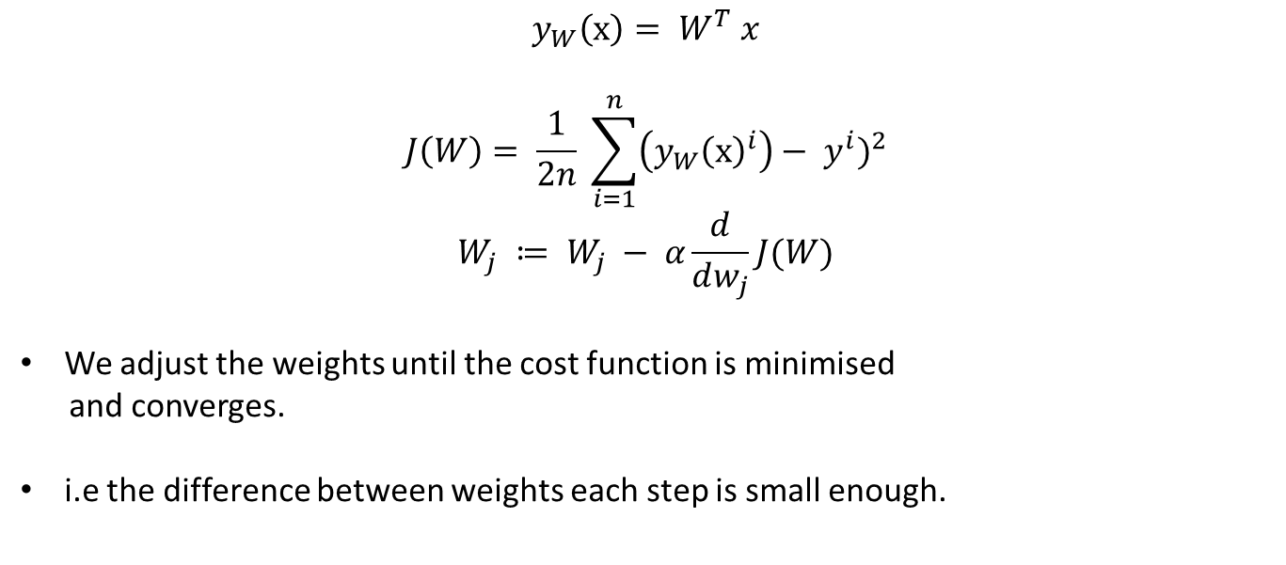
Linear Regression – Gradient Descent
$$y_{W}\left(x\right)= W^{T} x$$
$$J\left(W\right)= \frac{1}{2n} \sum_{i=1}^{n}{{\left({y_{W}\left(x\right)}^{i}\right)− y^{i})}^{2}}$$
$$W_{j} ≔ W_{j} − α\frac{d}{dw_{j}}J(W)$$
We adjust the weights until the cost function is minimised
and converges.
i.e the difference between weights each step is small enough.

Slide 62

Linear Regression – Gradient Descent
$$y_{W}\left(x\right)= W^{T} x$$
$$J\left(W\right)= \frac{1}{2n} \sum_{i=1}^{n}{{\left({y_{W}\left(x\right)}^{i}\right)− y^{i})}^{2}}$$
$$W_{j} ≔ W_{j} − α\frac{d}{dw_{j}}J(W)$$
We need to work out what $\frac{d}{dw}J(W)$ is.

Slide 63

Linear Regression – Gradient Descent
$$y_{W}\left(x\right)= W^{T} x$$
$$J\left(W\right)= \frac{1}{2n} \sum_{i=1}^{n}{{\left({y_{W}\left(x\right)}^{i}\right)− y^{i})}^{2}}$$
$$W_{j} ≔ W_{j} − α\frac{d}{dw_{j}}J(W)$$
We need to work out what $\frac{d}{db_{j}}J(W)$ is – Using differentiation we get:
$$\frac{d}{db_{j}}J\left(W\right)=\frac{1}{n} \sum_{i=1}^{n}{\left({y_{W}\left(x\right)}^{i}\right)− y^{i})x_{j}^{(i)}}$$

Slide 64

Linear Regression – Gradient Descent
$$y_{W}\left(x\right)= W^{T} x$$
$$J\left(W\right)= \frac{1}{2n} \sum_{i=1}^{n}{{\left({y_{W}\left(x\right)}^{i}\right)− y^{i})}^{2}}$$
Which gives:
$$W_{j} ≔ W_{j} − α\frac{1}{n} \sum_{i=1}^{n}{\left({y_{W}\left(x\right)}^{i}\right)− y^{i})x_{j}^{(i)}}$$

